Slide 1
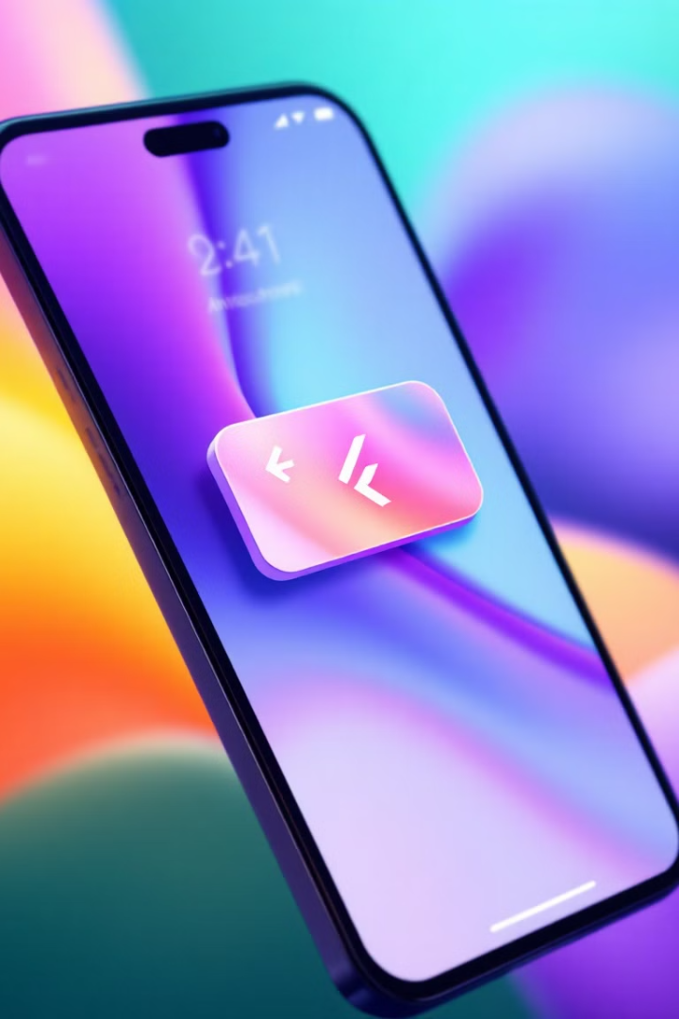

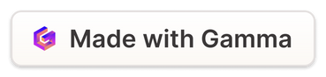
Advanced Visual and Motion Design in Flutter
CSE413: Mobile Application Design
Enhance user experience in Flutter apps through advanced UI elements, animations, and microinteractions.
We'll explore custom themes, animations, microinteractions for user engagement, and motion graphics using Flutter's animation framework.
Notes:
1

Slide 2
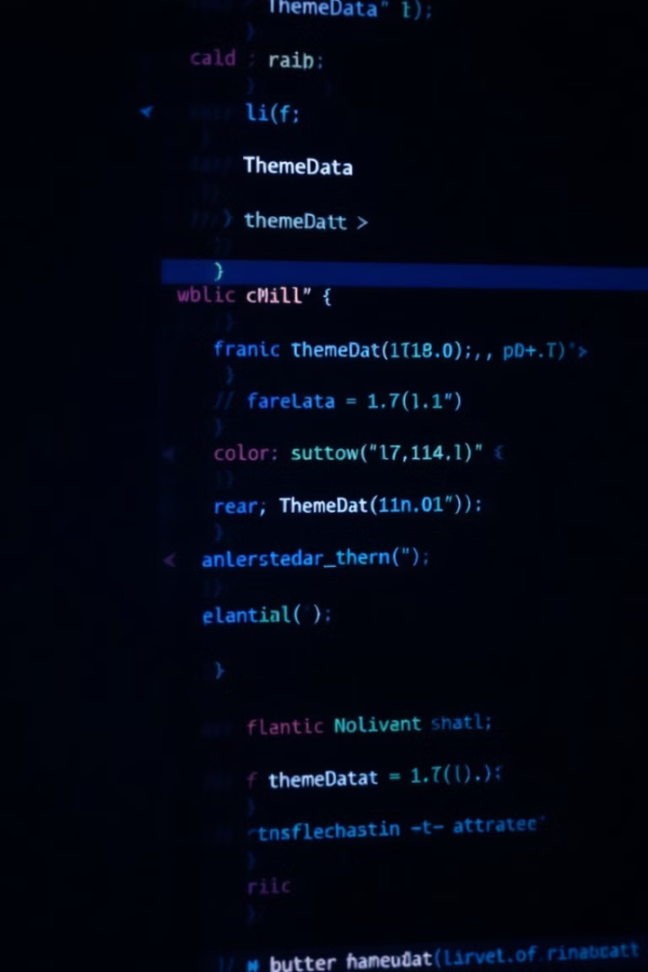
Advanced UI Elements in Flutter
Custom Themes
Theme Implementation
Flutter's ThemeData allows for consistent theming across the app with primaryColor, accentColor, and textTheme properties.
Use MaterialApp's theme parameter to apply custom ThemeData to your entire application.
Custom Animations
Leverage AnimationController and Tween for creating custom animations with precise control.
Notes:
2

Slide 3
Code Snippet for Custom Themes:
final ThemeData customTheme = ThemeData(
primaryColor: Colors.deepPurple,
accentColor: Colors.teal,
scaffoldBackgroundColor: Colors.white,
textTheme: TextTheme(
headline1: TextStyle(fontSize: 32, fontWeight: FontWeight.bold),
bodyText1: TextStyle(fontSize: 16, color: Colors.black87),
),
);
void main() {
runApp(MaterialApp(
theme: customTheme,
home: MyHomePage(),
));
}

Slide 4
Code Snippet for Custom Animations:
class AnimatedContainerExample extends StatefulWidget {
const AnimatedContainerExample({super.key});
@override
_AnimatedContainerExampleState createState() => _AnimatedContainerExampleState();
}
class _AnimatedContainerExampleState extends State<AnimatedContainerExample>
with SingleTickerProviderStateMixin {
late AnimationController _controller; // Use `late` for deferred initialization.
late Animation<double> _animation;
@override
void initState() {
super.initState();
_controller = AnimationController(
duration: const Duration(seconds: 2),
vsync: this,
)..repeat(reverse: true); // Automatically repeat the animation with reverse.
_animation = Tween<double>(begin: 100, end: 200).animate(_controller); // Tween interpolation.
}
}
@override
Widget build(BuildContext context) {
return Scaffold(
appBar: AppBar(title: const Text('Animated Container Example')),
body: Center(
child: AnimatedBuilder(
animation: _animation,
builder: (context, child) {
return Container(
width: _animation.value,
height: _animation.value,
color: Colors.blue,
);
},
),
),
);
}

Slide 5
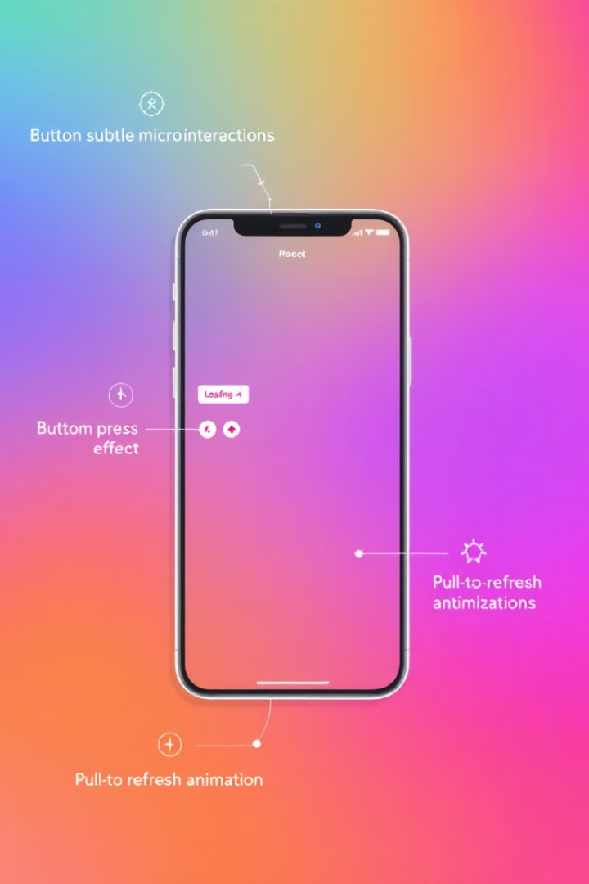


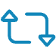
Microinteractions in Flutter
Button Effects
Loading Spinners
Swipe Animations
Create responsive button press effects that provide immediate visual feedback.
Implement engaging loading indicators to maintain user attention during wait times.
Add swipe-to-refresh animations that feel natural and intuitive.
Use Flutter's InkWell or GestureDetector widgets to implement touch interactions for these microinteractions.
Notes:
3

Slide 6
Code Snippet for Micro Interactions:
class MicrointeractionExample extends StatelessWidget {
const MicrointeractionExample({super.key});
@override
Widget build(BuildContext context) {
return Scaffold(
body: Center(
child: InkWell(
onTap: () {
// Handle tap
},
child: Container(
padding: EdgeInsets.all(16),
decoration: BoxDecoration(
color: Colors.blue,
borderRadius: BorderRadius.circular(8),
),
child: Text(
'Press Me',
style: TextStyle(color: Colors.white, fontSize: 18),
),
),
),
),
);
}
}

Slide 7
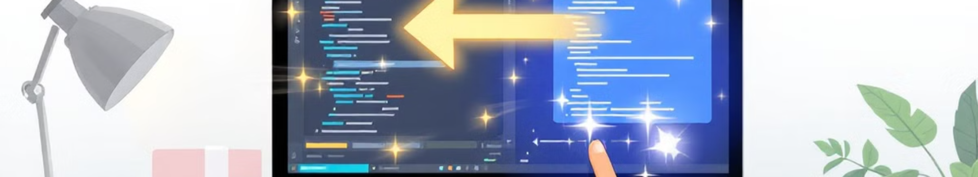
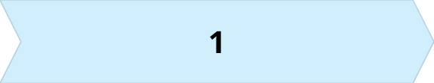
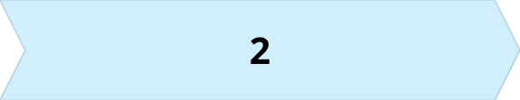
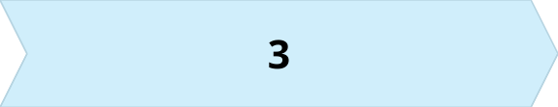
Tools for Creating Motion Graphics
AnimatedContainer
AnimatedOpacity
Hero
Implicitly animates changes to container properties like size, color, and padding.
Creates smooth fade-in and fade-out transitions for widgets.
Enables seamless transitions of shared elements between screens.
Flutter's animation framework provides these powerful tools for creating smooth, engaging transitions.
Notes:
4

Slide 8
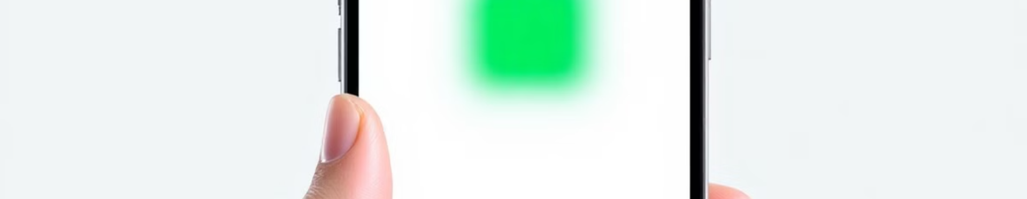
Animated Opacity Example
Add AnimatedOpacity
Implement Toggle Function
Use AnimatedOpacity with duration and opacity properties based on state.
Create Stateful Widget
Add _toggleVisibility() to switch between visible and hidden states.
Start with a StatefulWidget to manage the visibility state.
Notes:
5

Slide 9
Code Snippet for Animated Opacity:
class AnimatedOpacityExample extends StatefulWidget {
const AnimatedOpacityExample({super.key});
@override
_AnimatedOpacityExampleState createState() => _AnimatedOpacityExampleState();
}
class _AnimatedOpacityExampleState extends State<AnimatedOpacityExample> {
bool _visible = true;
void _toggleVisibility() {
setState(() {
_visible = !_visible;
});
}
@override
Widget build(BuildContext context) {
return Scaffold(
body: Center(
child: Column(
mainAxisAlignment: MainAxisAlignment.center,
children: <Widget>[
AnimatedOpacity(
opacity: _visible ? 1.0 : 0.0,
duration: Duration(seconds: 1),
child: Container(
width: 200,
height: 200,
color: Colors.green,
),
),
ElevatedButton(
onPressed: _toggleVisibility,
child: Text(_visible ? 'Hide' : 'Show'),
),
],
),
),
);
}
}

Slide 10
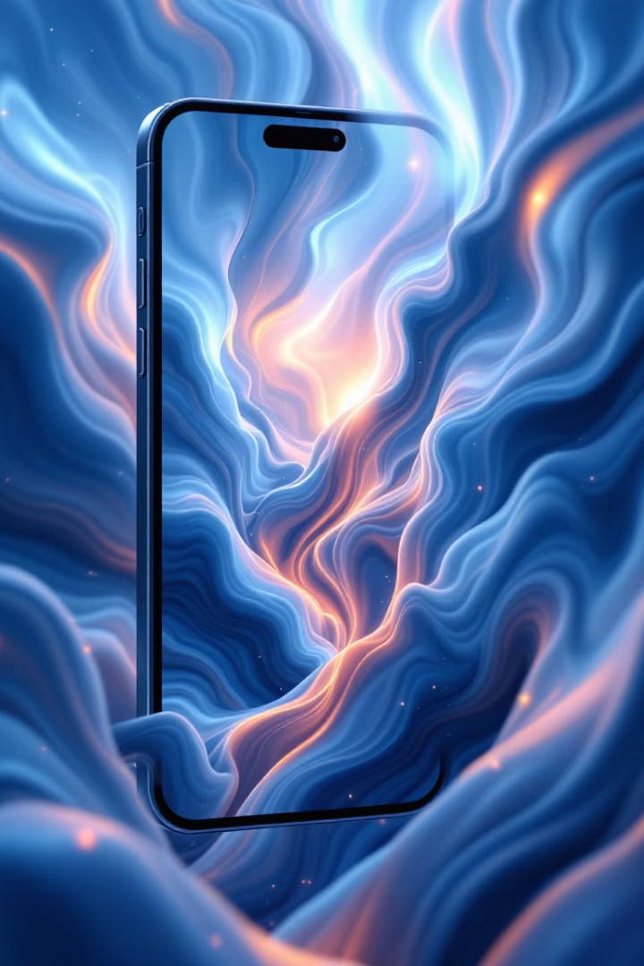
Hero Animations
1
First Screen
Create a Hero widget with a unique tag and wrapped around an image.
2
Navigation
Use Navigator.push to transition to the detail screen when tapped.
3
Detail Screen
Add matching Hero widget with the same tag but larger dimensions.
Hero animations create seamless transitions between screens, maintaining visual continuity.
Notes:
6

Slide 11
Code Snippet for Hero Animation:
class HeroAnimationExample extends StatelessWidget {
const HeroAnimationExample({super.key});
@override
Widget build(BuildContext context) {
return Scaffold(
body: Center(
child: InkWell(
onTap: () {
Navigator.push(context, MaterialPageRoute(builder: (_) {
return DetailScreen();
}));
},
child: Hero(
tag: 'imageHero',
child: Image.network(
'https://picsum.photos/200',
width: 100,
height: 100,
),
),
),
),
);
}
}
class DetailScreen extends StatelessWidget {
const DetailScreen({super.key});
@override
Widget build(BuildContext context) {
return Scaffold(
appBar: AppBar(
title: const Text('Detail Screen'),
),
body: Center(
child: Hero(
tag: 'imageHero',
child: ClipRRect(
borderRadius: BorderRadius.circular(16.0), // Ensure consistent design
child: Image.network(
'https://picsum.photos/200',
width: 300,
height: 300,
),
),
),
),
);
}
}

Slide 12
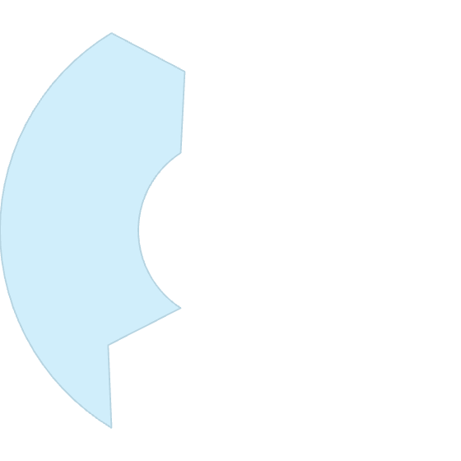
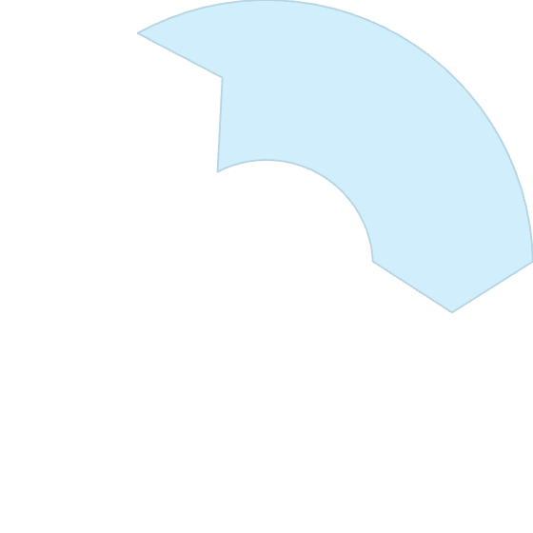
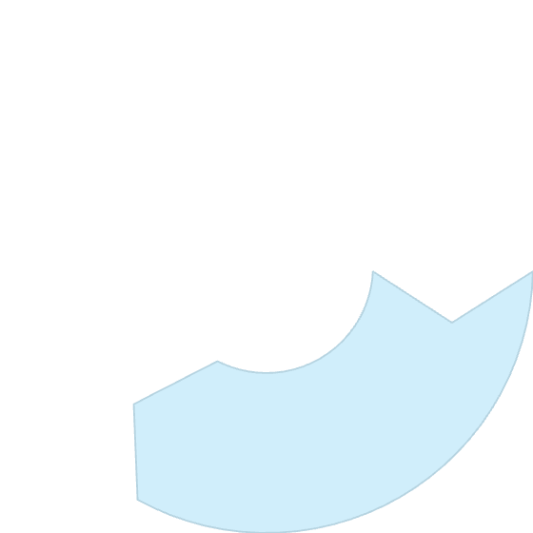
Rive Integration
Create Animation
2
Design your animation using the Rive editor.
Import Package
1
Add the Rive package to your pubspec.yaml file.
Implement Widget
3
Use RiveAnimation.asset to display the animation in your app.
Rive (formerly Flare) allows you to integrate complex, interactive motion graphics into Flutter applications.
Notes:
7

Slide 13
Code Snippet for Rive Integration:
import 'package:rive/rive.dart';
class RiveAnimationExample extends StatelessWidget {
@override
Widget build(BuildContext context) {
return Scaffold(
body: Center(
child: RiveAnimation.asset(
'assets/animation.riv',
fit: BoxFit.cover,
),
),
);
}
}

Slide 14
Best Practices
Performance
Accessibility
Use const constructors where possible
Provide alternatives for reduced motion
Avoid unnecessary animations in large lists
Use MediaQuery to detect preferences
Optimize widget rebuilds
bool reduceMotion = MediaQuery.of(context).disableAnimations;
Test with accessibility tools
Following these best practices ensures your animations are both performant and accessible to all users.
Notes:
8

Slide 15
Thank you!

